Slide 1

GROUP 13
PARJANYA RAJPUT
(202201115)
ADITYA RAINA
(202201466)
TANMAY SINGH
(202201135)
Ar se
USER CENTRIC DESIGN
PROF: ANUPAM RANA

Slide 2






ARISE
BACKGROUND
INFORMATION
TABLE OF
CONTENT
COMPETITIVE
ANALYSIS
USER
SURVEY
USER

Slide 3

BACKGROUND
INFORMATION
ARISE is an innovative application designed to empower individuals in overcoming deaddiction and incorporating lifestyle change by supporting habit tracking and establishing positive routines.
ARISE provides a structured and supportive environment to guide users every step of the way. Key features include habit streaks and milestones, daily journal daily check-ins and blogs, a community feed, success stories and expert councellor advice.

Slide 4

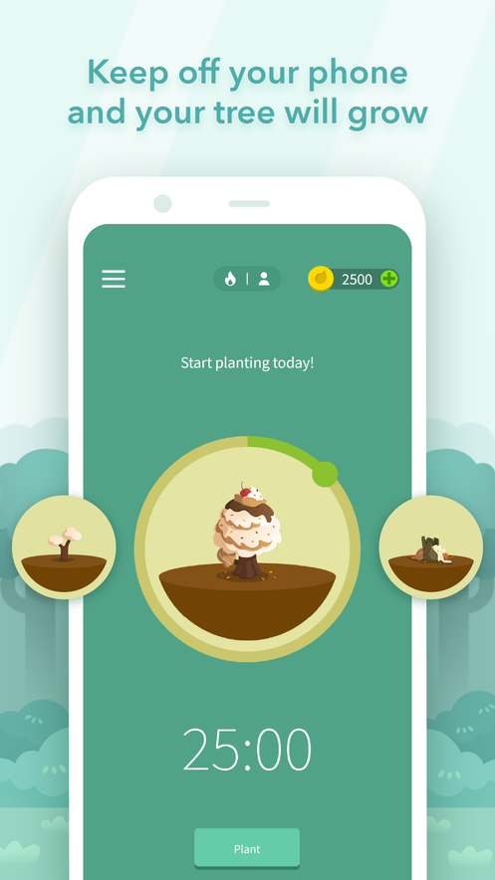
COMPETITIVE ANALYSIS
STRENGTHS
Gamified Focus Tool: Forest uses a unique tree-planting concept where staying focused grows a virtual tree.
Progress Visualization: The app displays a virtual forest of completed focus sessions.
1) Forest
WEAKNESSES
Key functionalities like advanced stats and group focus modes are locked behind a subscription.
No feature for notification or distractions blocking.

Slide 5
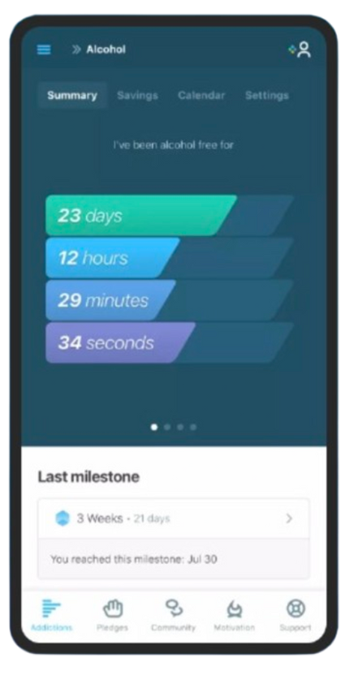

COMPETITIVE
ANALYSIS
STRENGTHS
A DETAILED COUNTEr showing time down to seconds.
Offers daily pledges, inspirational quotes, and milestone
2) I am Sober
WEAKNESSES
Doesn’t tracks days sober for multiple addictions.
No feature like community groups or counsellor support.

Slide 6
QUESTIONNAIRE
Age
Gender
Location
What is your Occupation?
Which addiction are you most focused on overcoming?
How long have you been struggling with this addiction?
What triggers your addiction most often?
What is your primary goal in overcoming this addiction?
Have you tried quitting this addiction before?
What kind of support do you find most effective?
How likely are you to use a journaling feature to record your thoughts and progress?
What kind of rewards would help you stay accountable in forming new healthier habits?
Which areas of self improvement are you interested in?
USER
SURVEY

Slide 7
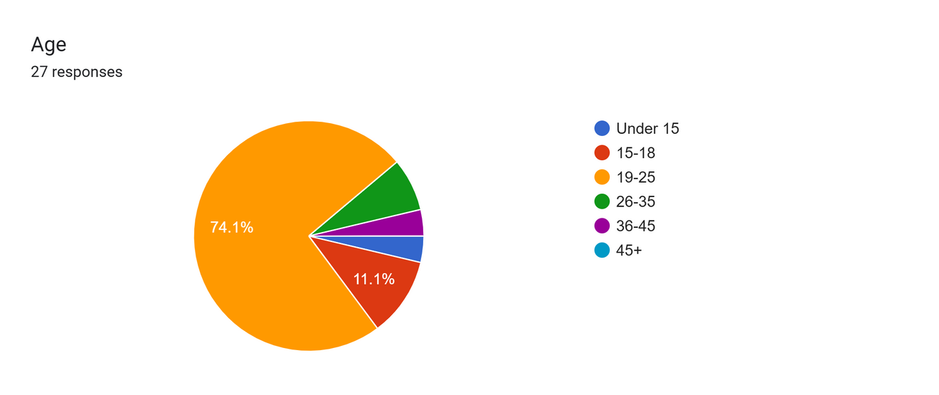
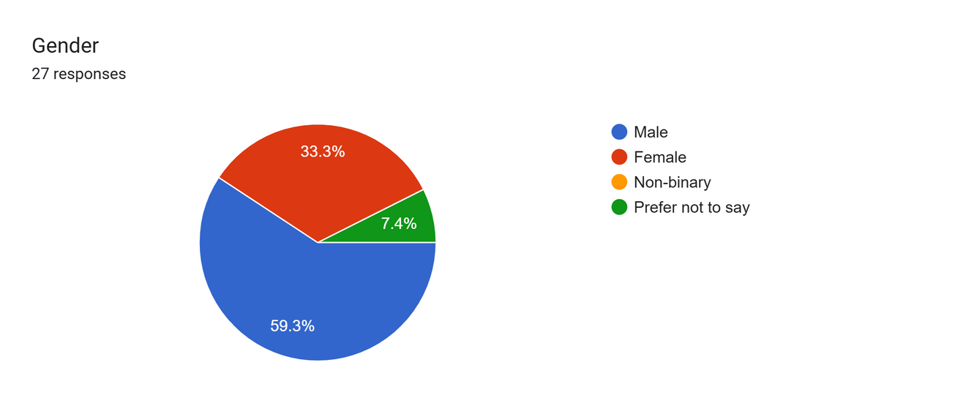
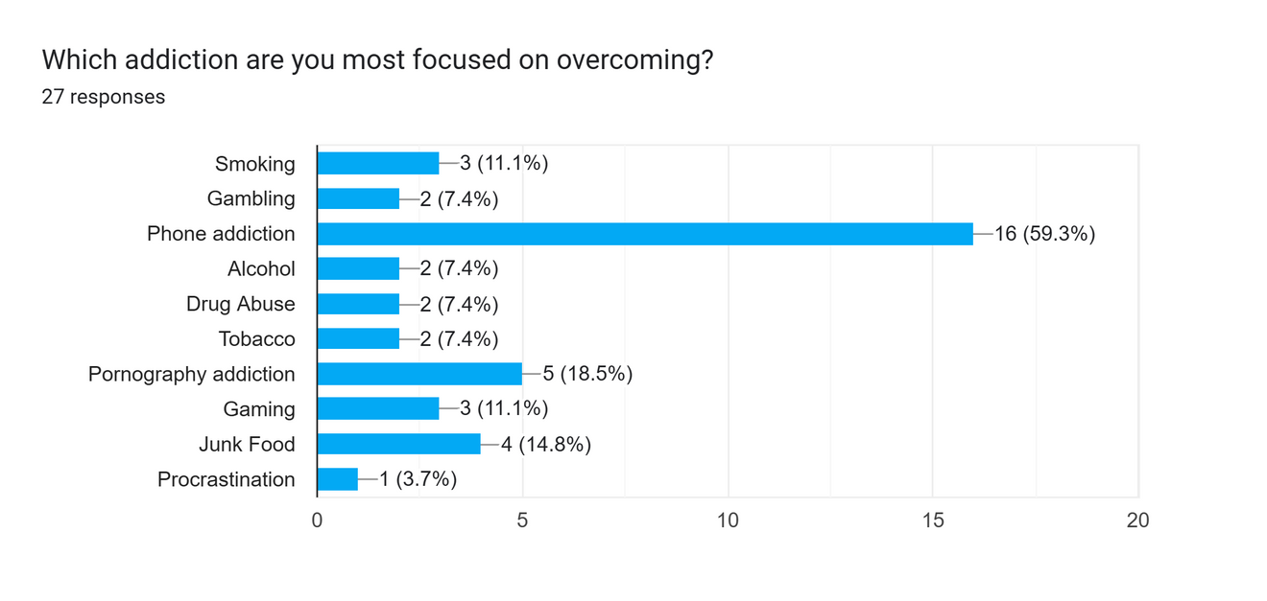
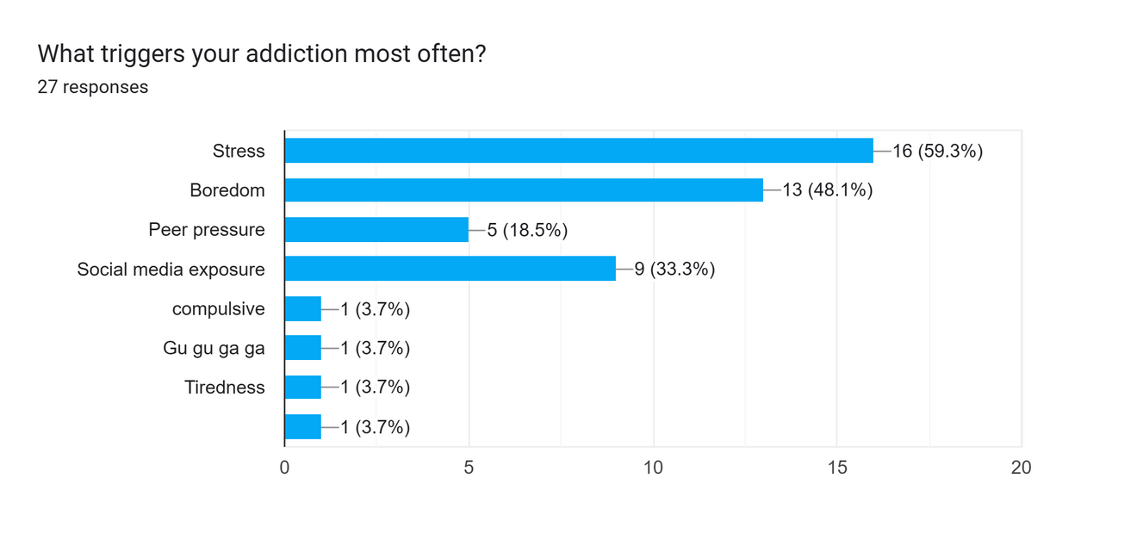
Survey
Results

Slide 8
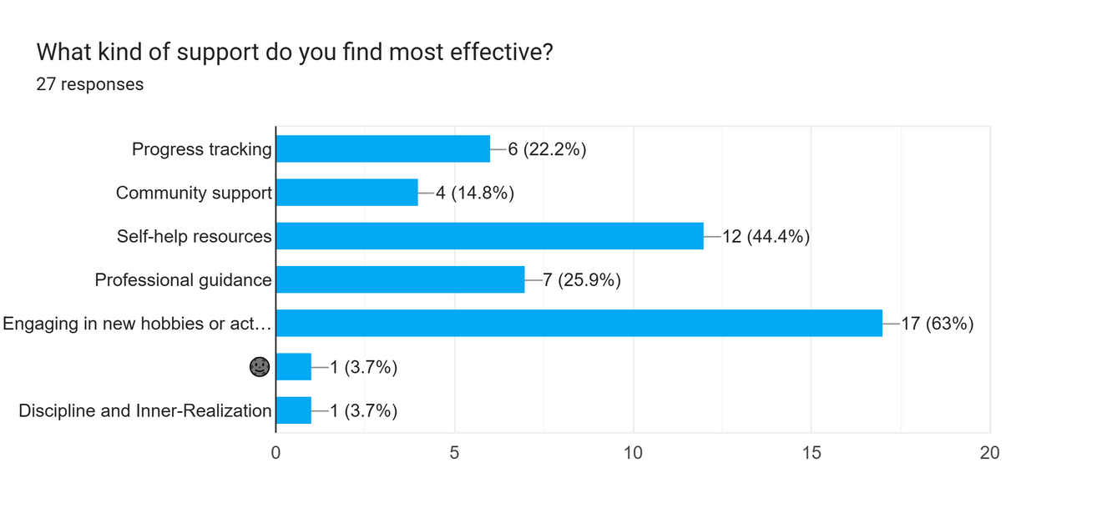
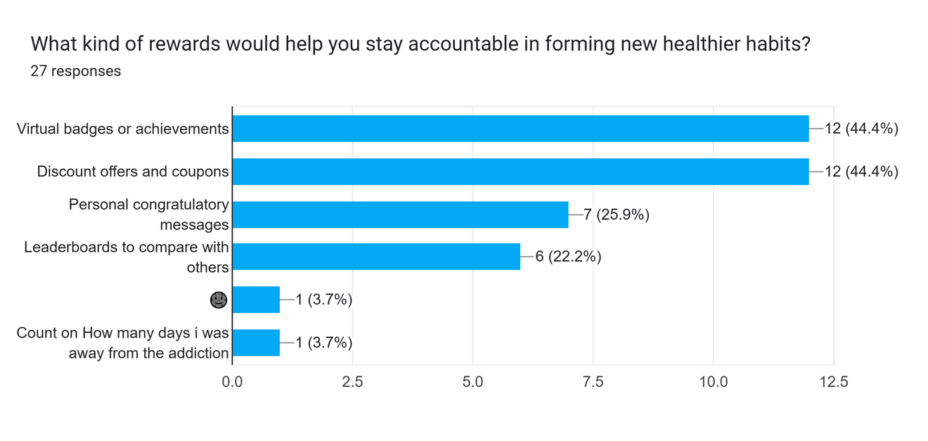
Survey
Results
60% people expressed interest in using an application for quitting phone addiction.
A relativity low score of 14.8% users believe community support is beneficial.
Stress, boredom, peer pressure and curiosity are the main reasons to start a bad habit.
88.8% people find it motivating to have virtual badges and discount offers in habit building app.

Slide 9


Rajesh Kumar
Background
Rajesh is a mid-level IT professional struggling with smoking and tobacco addiction for over 3 years. He started smoking due to workplace stress and peer pressure but now wants to quit to improve his health and finzances. Despite multiple attempts to quit (relapsed each time), he feels trapped in the cycle of addiction.
Struggles
Motivations
Age: 28
Intense cravings during stressful situations
Difficulty maintaining self-discipline
Lack of accessible alternatives to manage stress
Wants to avoid health risks (e.g., respiratory issues) linked to smoking
Desires to have more free time for hobbies and socializing
Aims to improve his mental and physical well-being
Occupation: Working Professional
Location: Gandhinagar
Every cigarette I avoid is a step toward a healthier life and a fuller wallet. I just need the right tools to stay on track.
Triggers
STRESS
Areas of Interest
BOREDOM
Fitness
Emotional Intelligence
Stress Management
MEDIA EXPOSURE

Slide 10
Empathy map
"I waste too much time on my phone instead of studying."
"I need a way to stop snacking when I’m stressed."
Scrolls social media endlessly when bored.
Eats junk food during late-night study sessions.
Thinks
Does
Feels
Says
Frustrated with her lack of self-control.
Anxious about falling behind in studies.
"I can’t stop checking my phone every five minutes."
"I feel so sluggish after eating junk food."

Slide 11

Leena Shah
Background
Leena is a second-year college student dealing with phone addiction and junk food cravings. She often turns to social media and unhealthy snacks when she feels stressed or bored. Priya has tried to quit these habits before but struggles with consistency. She is looking for a structured way to build healthier habits and manage her time better.
Struggles
Motivations
Age: 20
Intense cravings during stressful situations
Emotional eating during stressful times
Lack of motivation without external support.
﻿Wants to feel more confident and in control of her life.
Desires to build healthier relationships and improve her social life.
Aims to achieve a balanced lifestyle with time for studies, hobbies, and self-care.
Occupation: College Student
Location: Ahmedabad
I want to break free from my phone and junk food habits so l can focus on my studies and feel better about myself.
Triggers
STRESS
Areas of Interest
BOREDOM
Self
Confidence
Emotional Intelligence
Communication Skills
MEDIA EXPOSURE

Slide 12
Empathy map
"I need a way to handle stress without cigarettes.”
"I’m tired of failing every time I try to quit."
Works long hours in IT and attends team meetings.
Smokes during breaks or when stressed.
Thinks
Does
Feels
Says
Stressed and overwhelmed by work.
Guilty about his smoking habit.
Hopeful yet doubtful about quitting for good.
"I need help staying disciplined."
"Quitting feels impossible sometimes."

Slide 13
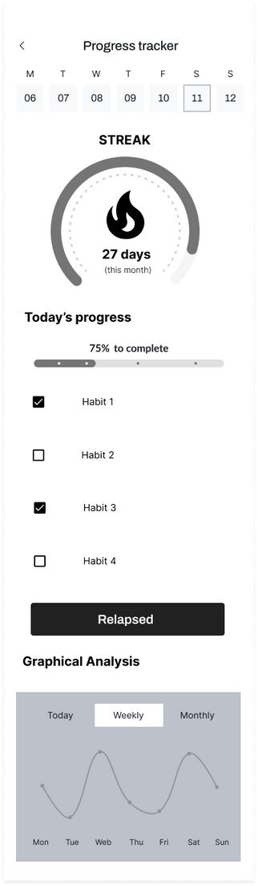
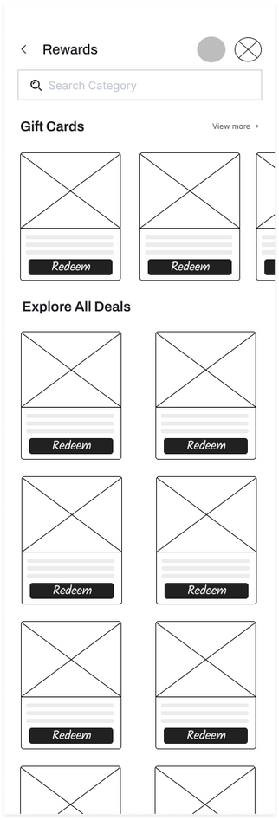
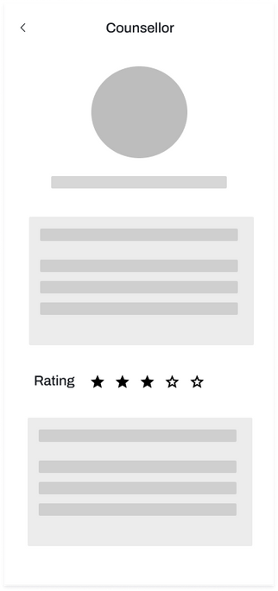
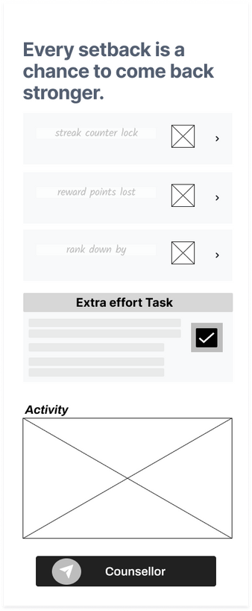
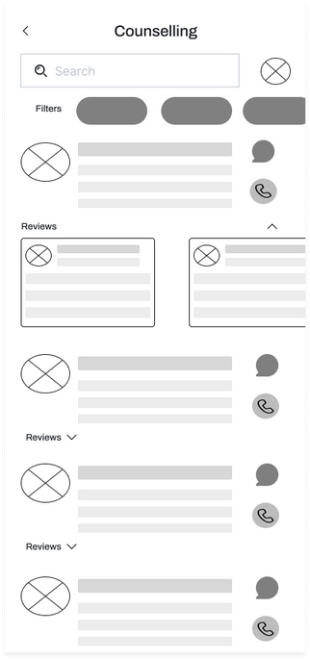
Low
Fidelity
Wireframe

Slide 14

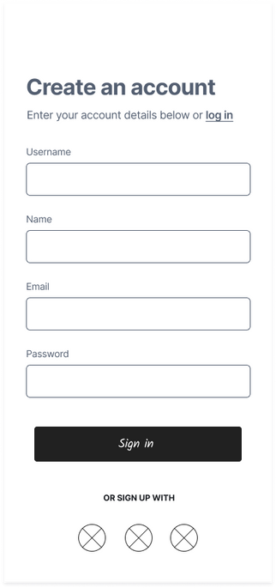
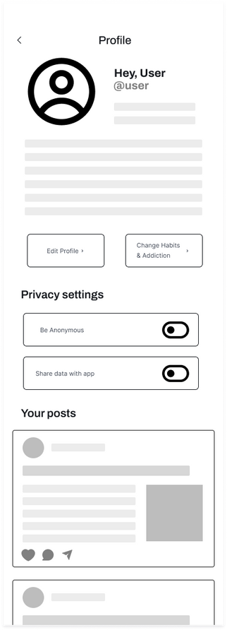
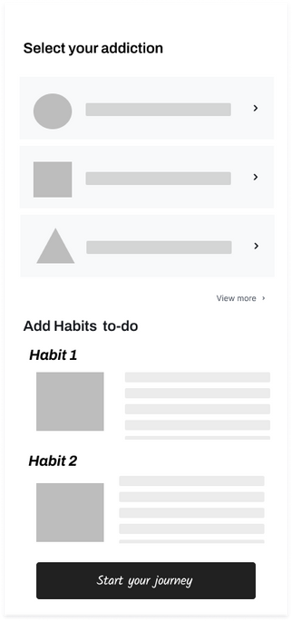
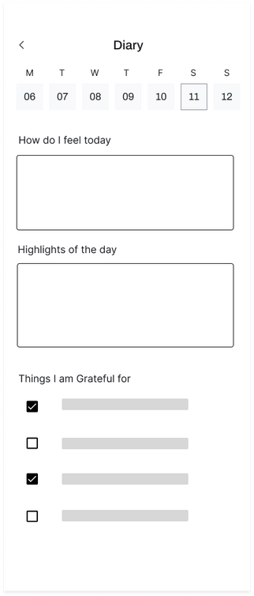
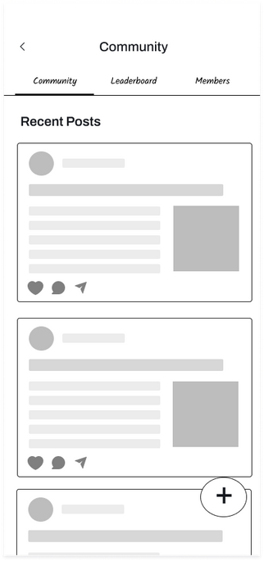
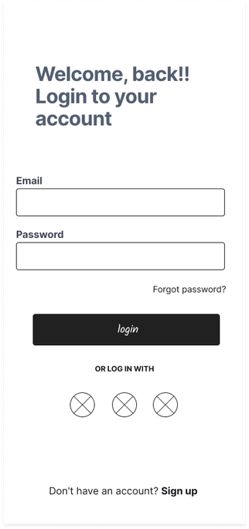
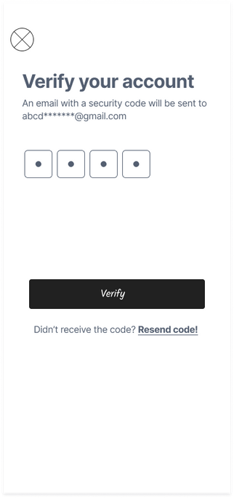
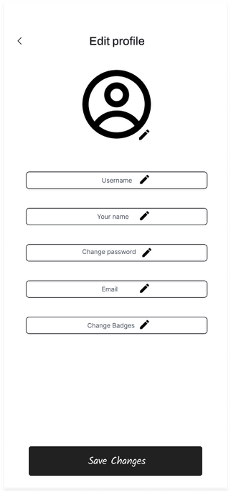
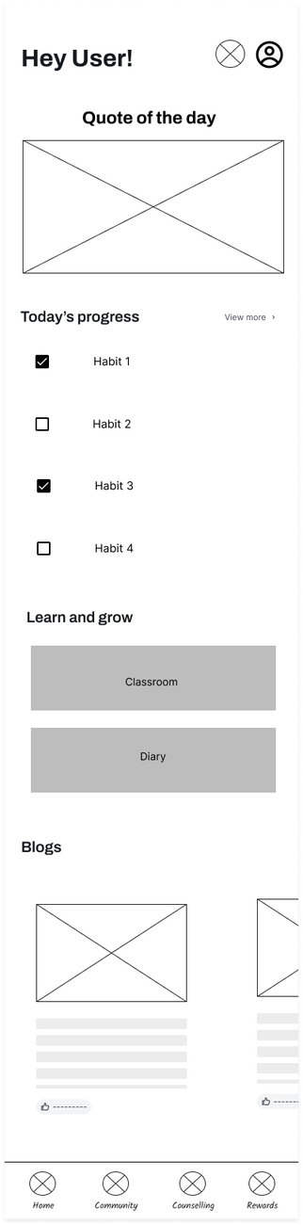
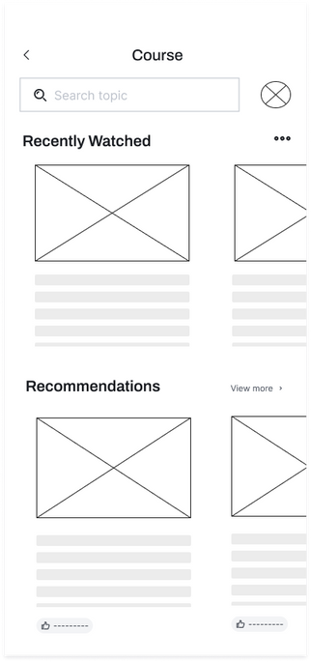
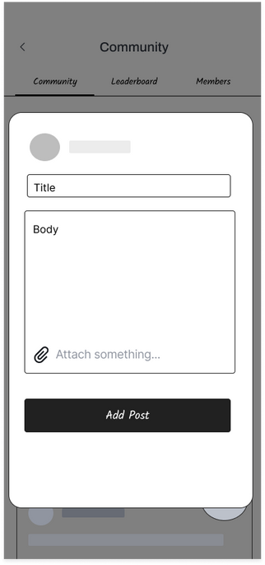

Slide 15
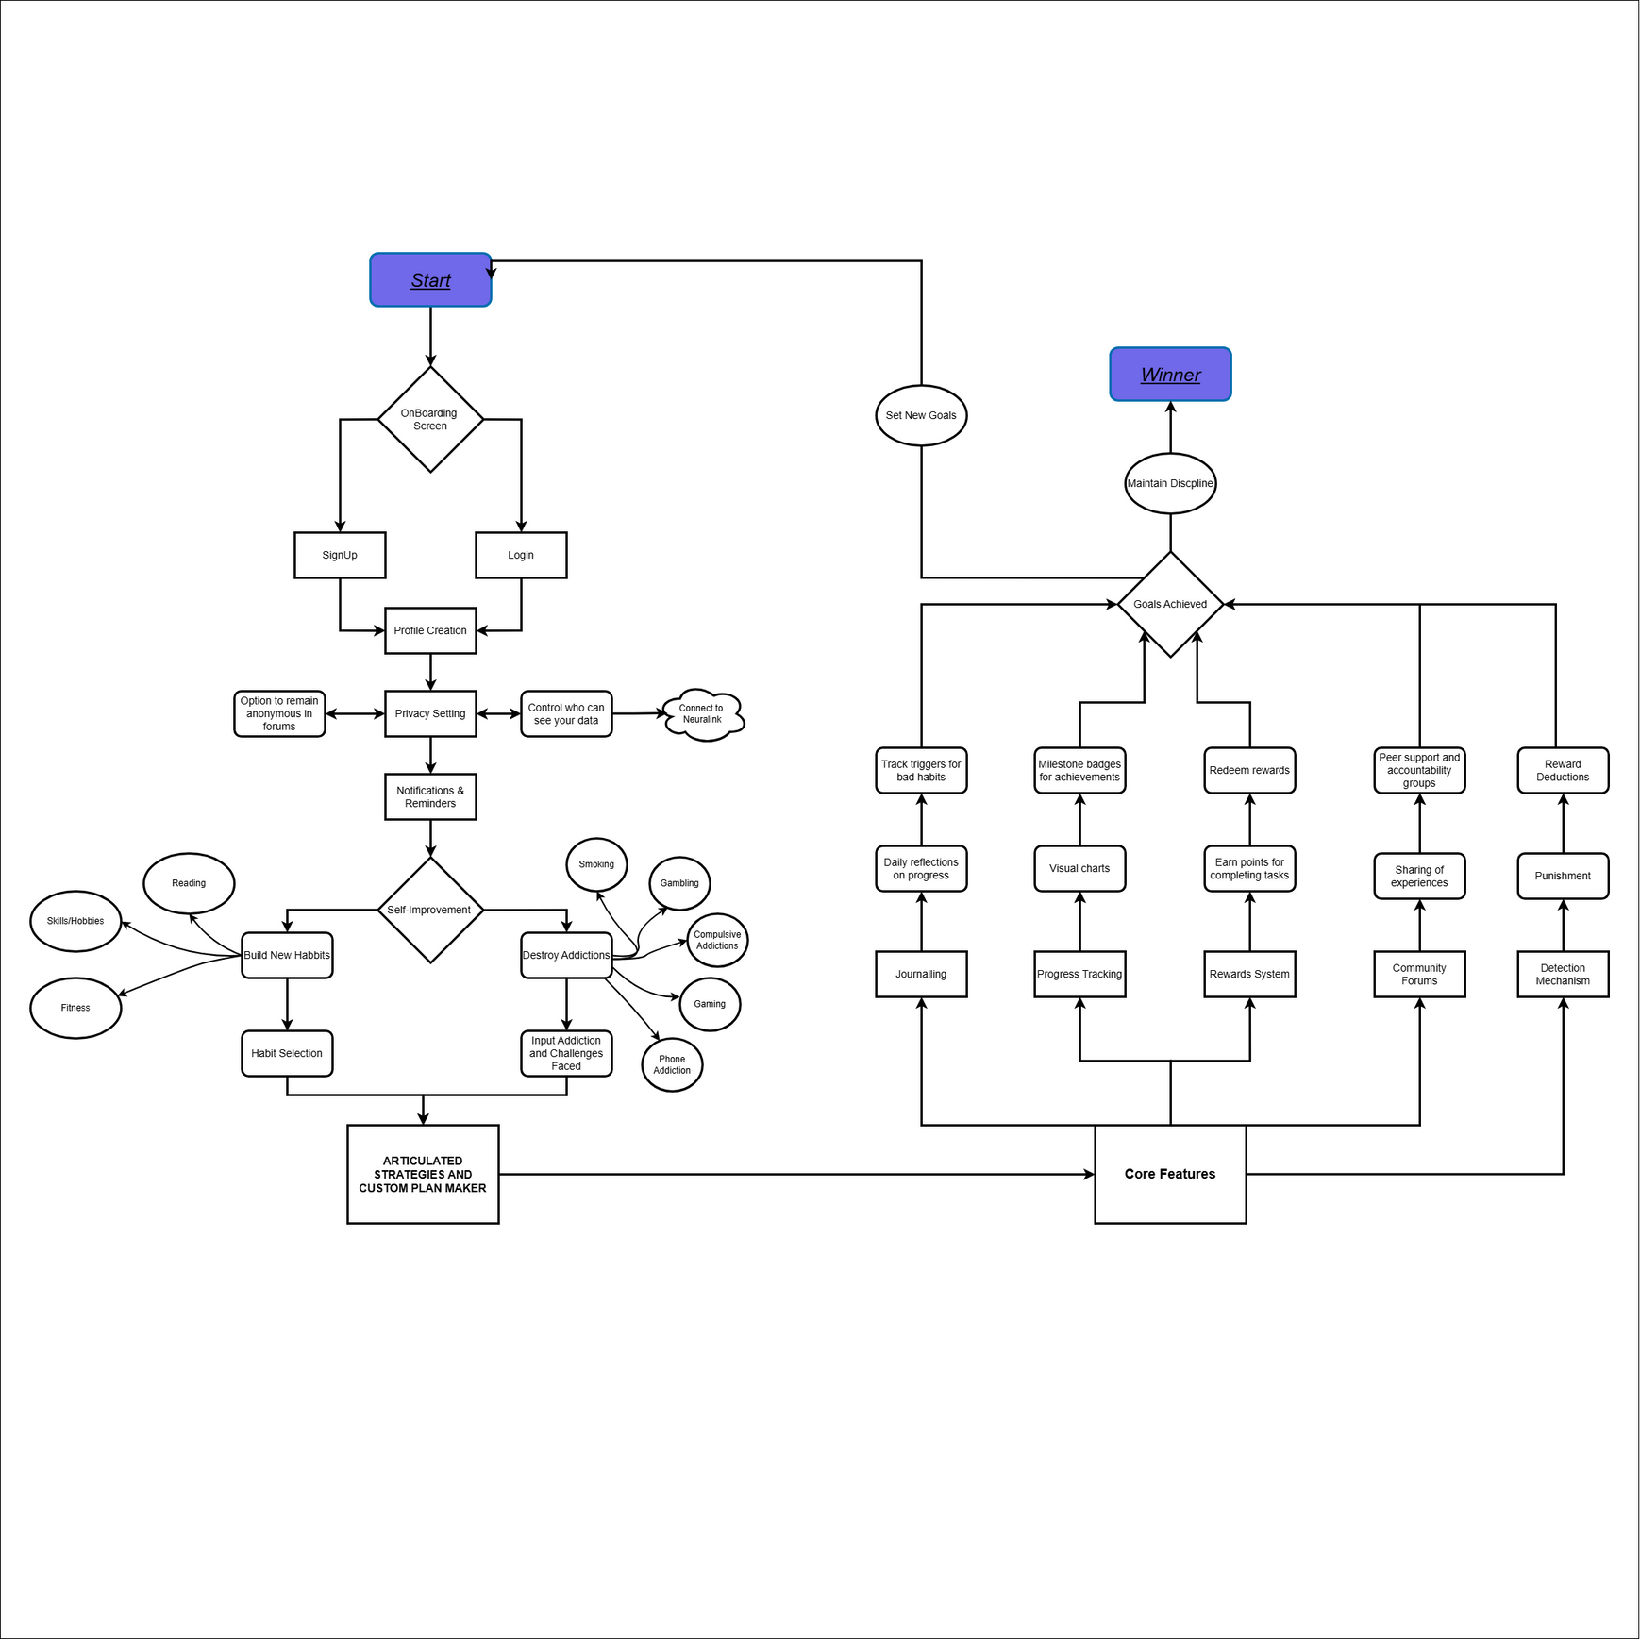
Information Architechture

Slide 16
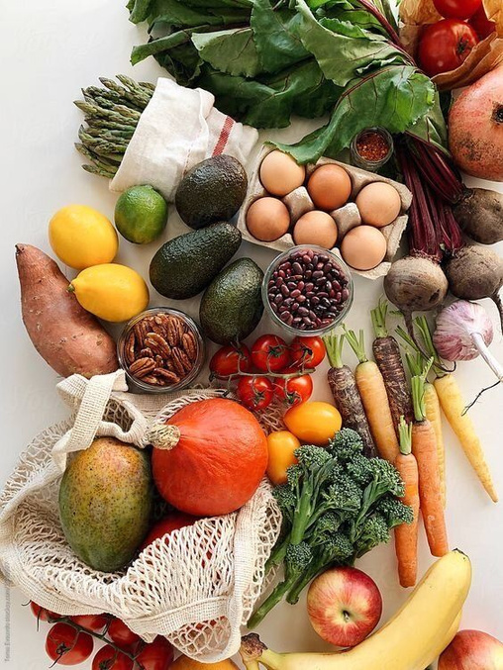
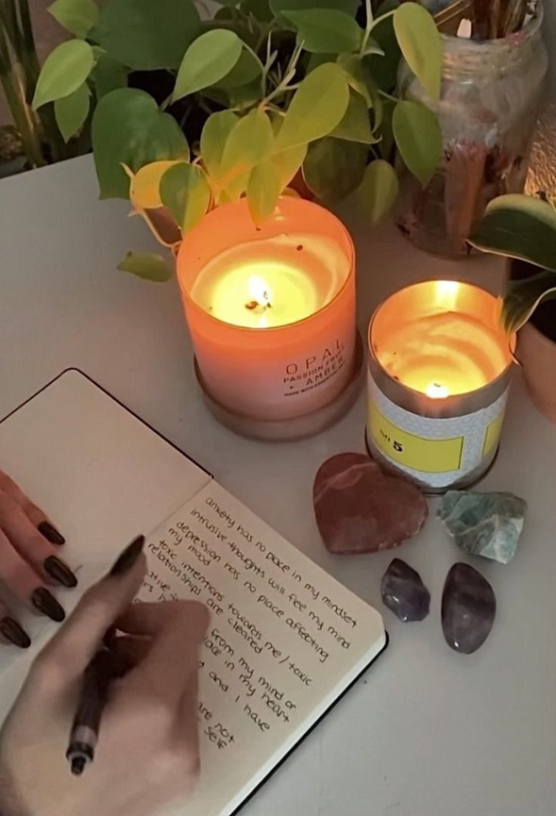


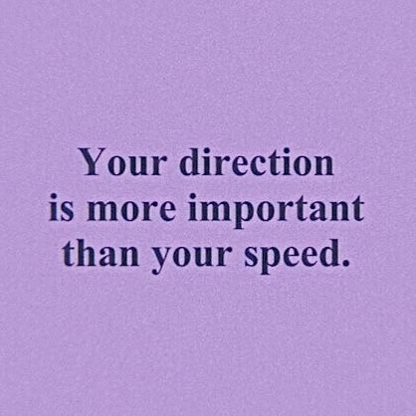
Mood
Board

Slide 17
Colour Palette And Typography
TYPOGRAPHY
Telegraf
Telegraf
Telegraf
#7069E9
#B090E9
#FFFFF
#00000
Nunito

Slide 18
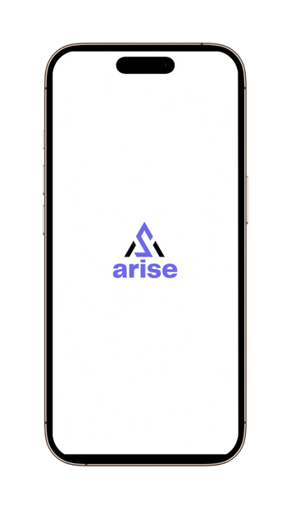
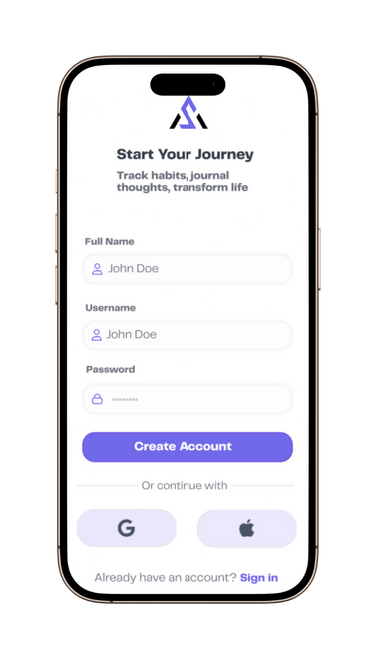
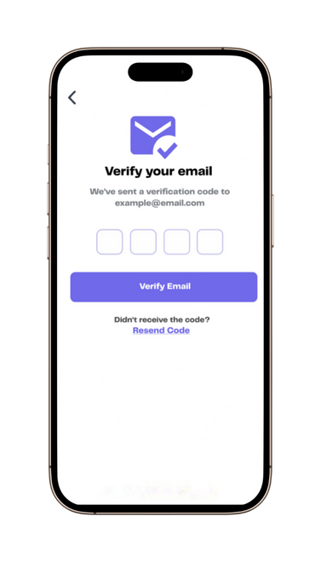
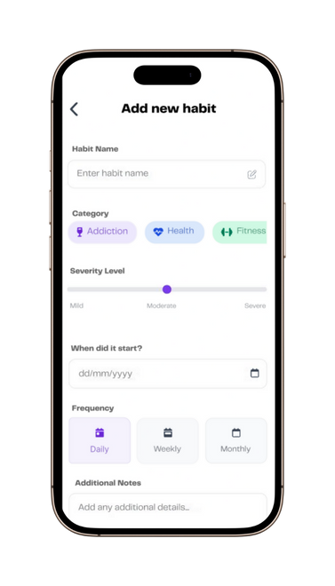
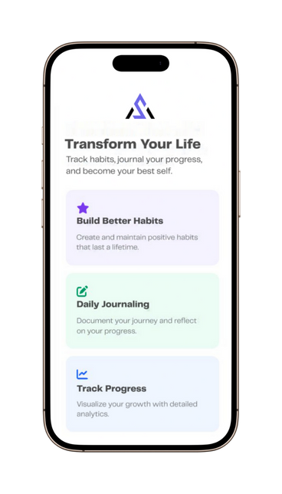
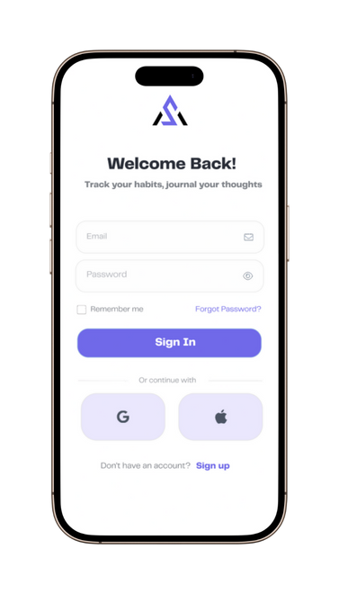
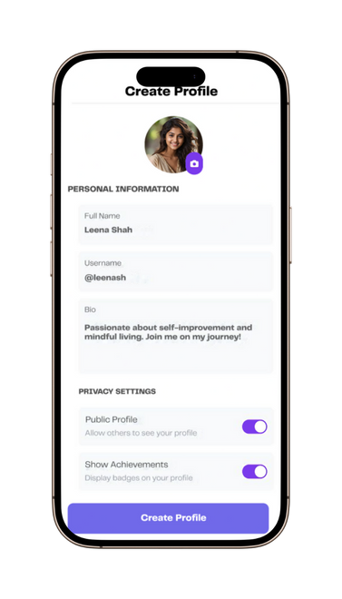
Hi-fidelity Wireframe

Slide 19
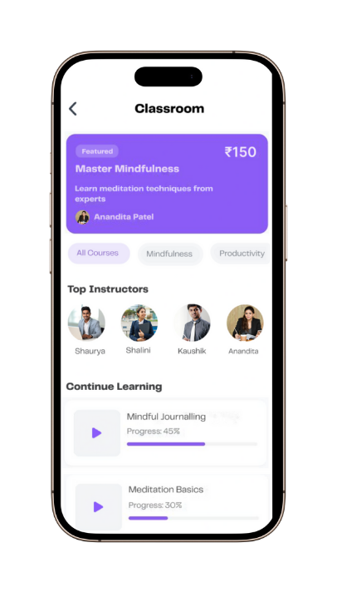
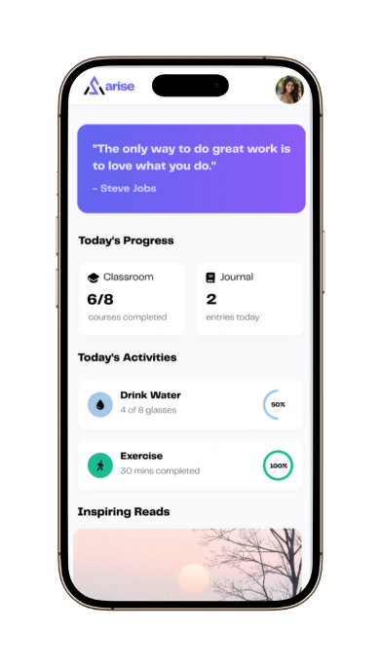
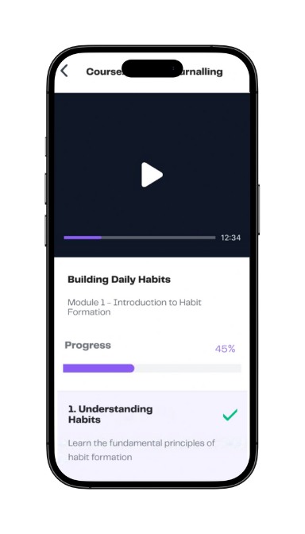
Todays progress
Classrooms
Interactive Content
Mark tasks as done or set reminders to stay on track with your goals.
Access expert-led sessions on habit formation, stress management, and deaddicti
Learn from professionals who share their insights and success strategies.

Slide 20
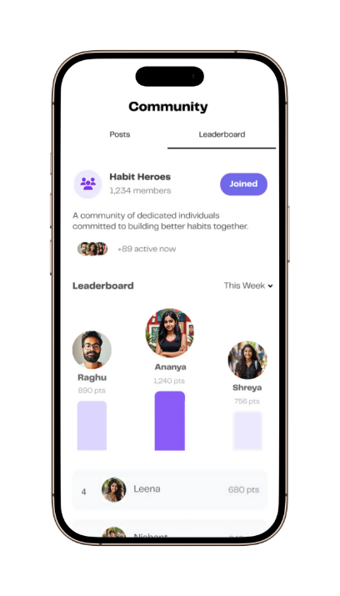
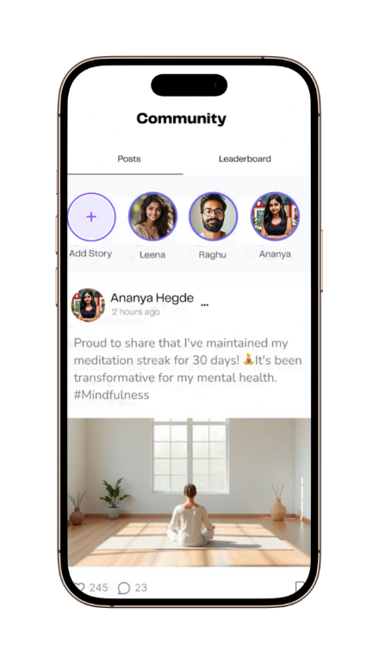
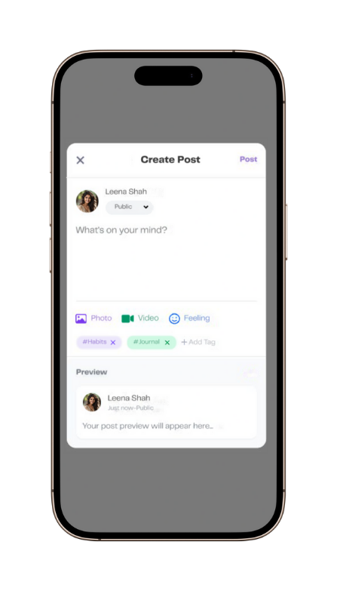
Community
Add new Post
Leaderboard
Join a supportive community to post updates, share your journey, and engage with others.
Share your progress, challenges, or milestones with the community.
Use prompts to reflect on your journey and gain clarity on your goals.

Slide 21
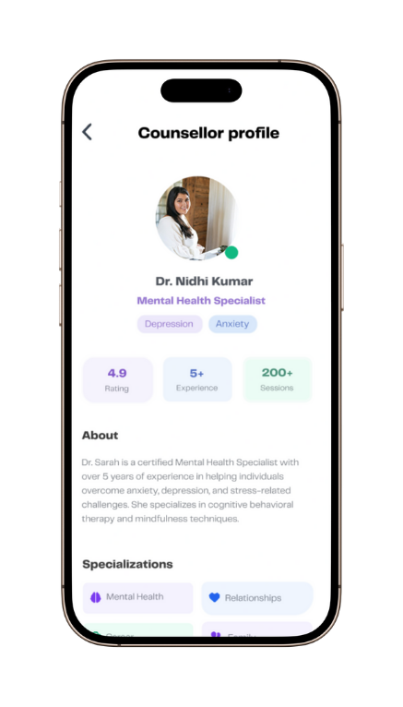
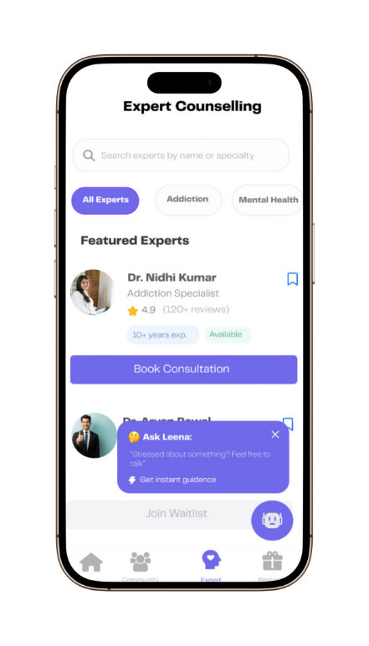
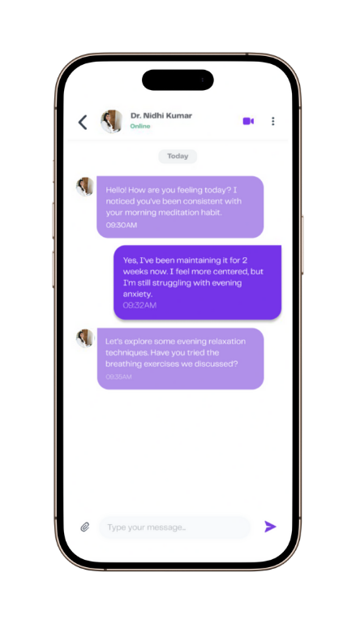
Counsellor
Personal connection
Safe space
Browse a curated list of expert counsellors specializing in deaddiction and habit formation.
Choose the right support for your journey.
Share your challenges and progress in a secure, private chat environment.

Slide 22
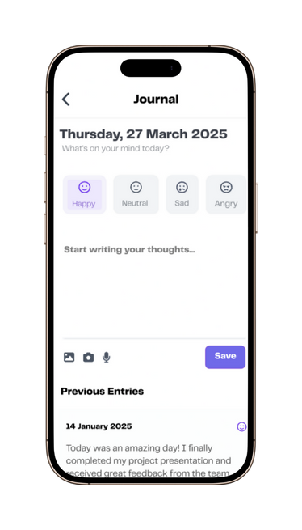
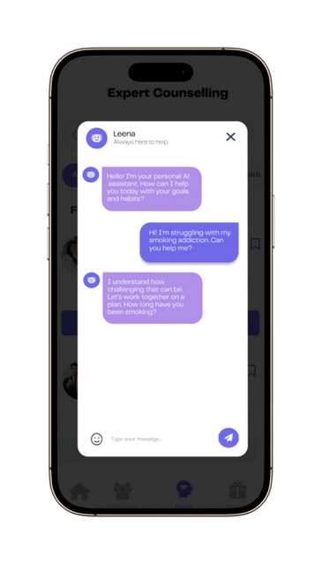
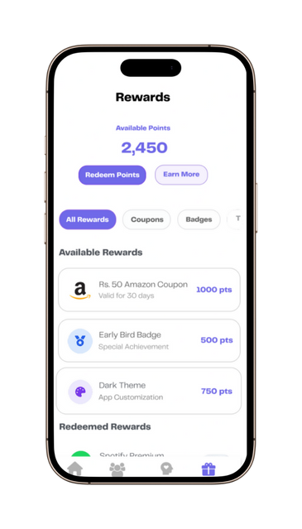
Rewards
Accumulate points through consistent habit tracking and redeem for coupons, themes, and exclusive perks.
Journal
Capture your thoughts and emotions daily to reflect on your journey and gain clarity on your goals.

Slide 23
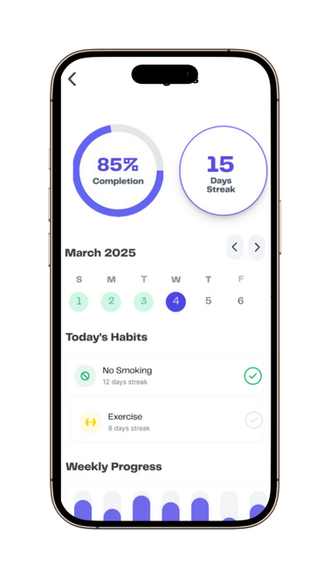
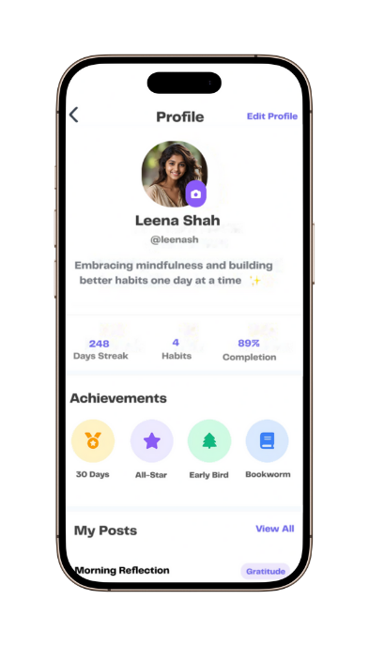
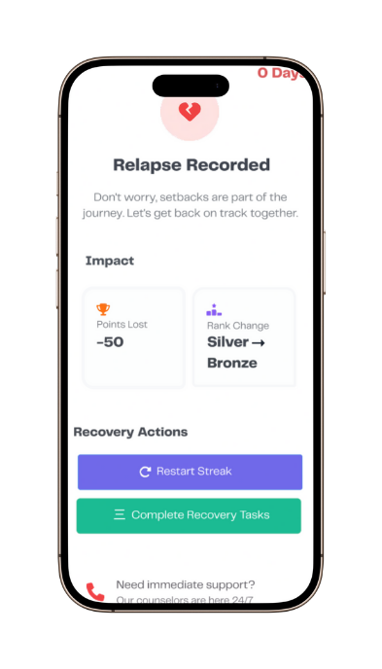
Milestone Recognition
Earn virtual badges and stay motivated with a clear calendar view of your habit streaks.
Bounce Back Stronger
Acknowledge setbacks and take guided steps to recover and rebuild momentum.

Slide 24




MOCKUP

Slide 25

USER JOURNEY MAP

Slide 26

GROUP
13
THANK YOU
Figma File includes three pages:
Low Fidelity
Hi-Fidelity
User Persona, Journey Map and Mockups
https://www.figma.com/design/VfbbKT9JdTfIIRjMFKW3Qe/Arise-UI-design?node-id=169-3876&t=PH8uyRfb8wBcIqD6-1
ARISE

